Slide 1

CHEZALINK
Where talent meets ambition, the launchpad for the next generation of sporting legends.

Slide 2

GROUP MEMBERS
RYAN KIMUTAI KORIR - Project Lead / Lead developer
BRIAN KAMAU - Backend developer
KWEYAH POLO - Frontend developer
JOSHUA MUIMI - UI/UX developer
HILLARY INYAIT - Data management/ Research

Slide 3
WHAT PROBLEM ARE WE FACING?
In Kenya, countless young athletes are suffering in silence, their dreams stifled by a lack of opportunity, exposure, and support.
Why should this young athletes not be given an opportunity?
Why should they not be given a platform to showcase themselves to the world?
We should aim to empower young athletes by giving them a platform to showcase their talent to the world, especially to scouts who can open the doors to the future they’ve always dreamed of.

Slide 4
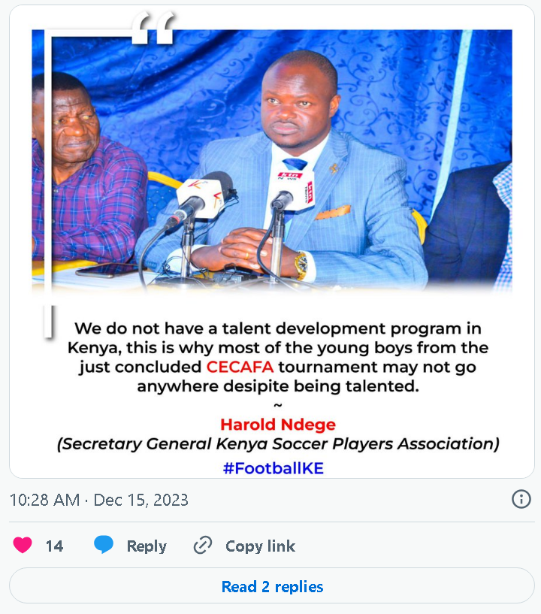
How many stories have we heard of supremely talented young footballers from Kenya’s marginalized areas, whose dreams are derailed not by lack of talent, but by overwhelming challenges beyond their control?

Slide 5
Key Challenges Identified (Based on Field Research in Kibera & Mathare)
Lack of Exposure & Recognition
Talented youth have no platform to showcase skills or achievements
Scouts and stakeholders struggle to discover grassroots talent
Financial Barriers
86% of youth cited lack of funding as a major issue
No allowances, poor facilities, and inconsistent training demotivate players
Weak Career Pathways
Youth view sport as a dead end due to no clear progression or support systems
Data from: “Challenges Faced By the Youth in Promoting Peace through Sport in Kibera and Mathare,” Kibe et al., 2015
https://www.academia.edu/92559852/Challenges_Faced_By_the_Youth_in_Promoting_Peace_through_Sport_in_Kibera_and_Mathare_Slums_Kenya

Slide 6
Our solution
We are building a platform designed to bridge the gap between raw talent and opportunity by enabling young athletes to showcase their talent directly to scouts who can help shape their professional journey.
We want it to be a “Linkedin for youth sports in Kenya”. A dedicated digital space for our young, aspiring athletes to showcase their talents, achievements, stats and progress to the nation and further beyond.

Slide 7
How does our solution solve the problem?
1. Visibility & Exposure
Most young athletes often remain unknown due to lack of platforms.
Our solution gives them a dedicated digital space to showcase their skills, achievements and progress accessible to verified scouts and coaches nationwide and beyond.

Slide 8
2. Data-Driven Profiles
Athletes can track and display verified stats (e.g. goals, assists, times, positions) updated by verified local leagues.
This helps scouts make well-informed decisions and athletes take control of their own development.

Slide 9
3. Content-driven Approach
With shortform videos, athletes can highlight skills, magic moments or training regiments visually. This is critical in a generation used to TikTok and Instagram reels-style content.
This enables young athletes to market themselves, even from the most remote or marginalized areas.

Slide 10
4. Scout Discovery Tools
Scouts and clubs can search/filter based on sport, age, region, youth-league and performance.
This will streamline talent identification. A scout can only keep track of so many youth tournaments and players.
We provide the tools to aid not to replace the scouts.
Instead of waiting for a tournament, a scout can discover talent any day at any time.

Slide 11
What makes our approach better and unique?
1. Tailored for the Kenyan youth
Most existing platforms (like LinkedIn, Hudl, or MaxPreps) are not designed for the Kenyan grassroots context.
Ours focuses specifically on young, underappreciated athletes, especially in those in marginalized areas with poor scouting networks.

Slide 12
2. Low barrier of entry
Our platform is designed and optimized to run on any low end smartphone.
It is designed with lightweight uploads and plenty of offline friendly features for those in areas with unreliable internet access.

Slide 13
3. Community-driven verification
Local league officials and coaches can verify data and performance adding credibility to stats and profiles.
This helps build trust between the unknown talents and the verified scouts.

Slide 14
4. Empowerment of the youth athletes
Unlike traditional methods that would require the young athletes to be part of well-reputed club or academy, our platform is inclusive and empowers the young athletes of all ages, backgrounds, religion and gender to showcase their talent.
Any young athlete with talent, access to a smartphone and parental/guardians consent can be seen.

Slide 15
How our project supports the new CBC system
The new Competency Based Curriculum (CBC) is focused on the discovery of talents, practical skills and hollistic development of students.
The CBC system encourages kids to pursue sports much more than its predecessor the “8-4-4 system”.
With the government’s major shift toward talent development through CBC, our platform offers a powerful tool to support both policymakers and aspiring young athletes in navigating this necessary and transformative transition.
Our platform aligns with the vision by:

Slide 16
1. Supporting Talent Identification
CBC encourages schools to identify and nurture learners’ unique talents early.
Our platform gives learners a space to showcase their sports highlights, achievements and progress - helping educators, parents, and scouts track development over time.

Slide 17
2. Creating Real-World Opportunities
CBC promotes career pathways based on strengths and interests of each individual learner.
Our platform helps bridge school-based sports with real opportunities for national and international exposure through scout access and the digital portfolios created by the young athletes.
This system has been proved to work wonders as demonstrated in the USA, where Highschool and Collegiate sports are well documented, followed, tracked and promoted by apps such as MaxPreps.

Slide 18
3. Encouraging Digital Literacy
CBC includes digital literacy and teaching learners responsible technology use.
Our platform helps learners build safe, constructive digital profiles while using technology for personal growth.

Slide 19
4. Supporting Teachers & Coaches
Coaches and PE teachers can use the platform to upload verified stats, highlights, track each learners progress, and recommend the top-performing athletes.
This will help with integrating sports development with learning assessment.

Slide 20
5. Inclusivity and empowerment
By focusing on marginalized youth, the project advances CBC’s goal of equity and inclusiveness.
This ensures all learners regardless of background, have the chance to succeed in sports.
It creates a fair playground for all the learners looking to pursue sports as a career.

Slide 21
SCALABILITY
ChezaLink is a multi-faceted platform that is scalable to multiple different sports from football all the way to swimming.
Our platform is also scalable to an international level. How many African countries face similar problems in their youth sports system?
With the rapidly growing African population, there will be an influx of many young athletes needing a platform to showcase their talents.
Hence an endless userbase.

Slide 22
OUR MISSION
We want our platform to give every young, aspiring athlete a chance to pursue their dreams. We foresee a future where every young athlete in Kenya plays knowing that their talent is seen and appreciated. We are creating this platform to simply act as an equaliser, give everyone a fair crack at the whip. We will strive to achieve this and hope to patner with people with a similar ambitious vision for youth sports in this country. We believe our platform will lead to a golden age in Kenyan sports. Vive la révolution.

Slide 23
“Sport has the power to change the world. It has the power to unite in a way that little else does. It speaks to youth in a language they understand.. Sport can create hope where once there was only despair”
Nelson Mandela

